Slide 1
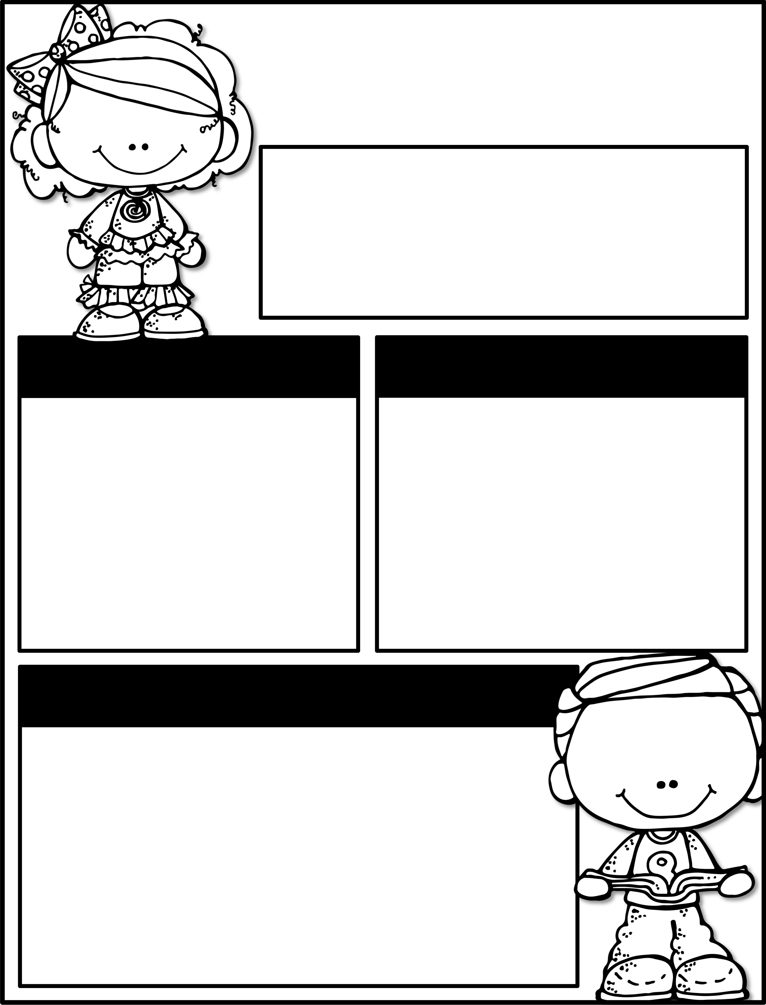
February 25th-March 1st
Parent Tip of the Week: Ask your child to introduce themselves to someone new at recess.
Upcoming Events
Reminders
Book Fair:
March 1st-7th
Open House:
March 7th (5:30-7:00)
Spring Break-
March 11th-15th
Complete one homework square a week. Homework is due on Friday, March 8th.
3rd Nine weeks testing will be done the week of March 4th-8th. Please make sure your child is present at school☺.
Learning Focus
Reading
Avid Readers
Writing
Persuasive Writing
Math
2D Shapes
Science
Animals & Habitats
Social Studies
Texas

