Slide 1
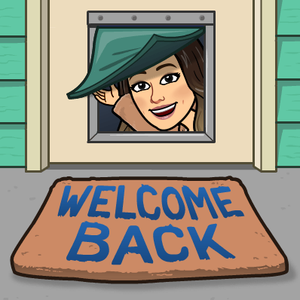
Welcome Families!
Mrs. Thompson’s 4th Grade Class

Slide 2
SCHOOL HOURS
8:30 School Begins
10:10 Specials
12:10 Recess
11:25 Lunch
3:45 Dismissal

Slide 3
PARENT – TEACHER COMMUNICATION
Please sign up for our class Dojo. This is the quickest way to communicate with us.
We will send ALL class updates, important information, and reminders through Class Dojo.

Slide 4
CLASSROOM ROUTINES
Water Bottles: Students will be allowed to have a water bottle kept in the classroom. Clear water is the only liquid allowed
Take Home Folders: Our students will have a take home folder that will go home every day. In this folder you will find the following: important notes home, paperwork that needs to be filled out and returned and student graded work.
*** Please check your child’s folder daily for notes or behavior infractions.

Slide 5
FORMS AND PROCEDURES
PLEASE FILL OUT THE FORMS ON THE LEFT AT YOUR CHILD’S SEAT.
* BEFORE LEAVING, PLEASE GIVE FORMS TO THE TEACHER AND CHECK YOUR CHILDS TRANSPORTATION INFORMATION.
If there are transportation changes and you ride a bus, please contact the bus barn ahead of time. In order to make ANY transportation changes a hand written note is REQUIRED, If there isn’t a note, I must send the child home the way they normally go.

Slide 6
PARENTS
VOLUNTEERING
CONTACTING ME
We welcome any parents who would like to volunteer in our classroom. If you’re interested in helping in our room, please contact me so we can set up times. We appreciate you taking time out of your schedule to get involved in our classroom. We need lots of help during our holiday parties, so be on the lookout for notes being sent home to sign up to help and/or donate party items.
Thank you for all your help and support!
Please fill out a volunteer form so that we may complete a background check.
My conference time is from 10:10-10:55.
You can also contact me by
Email – bailey.thompson@sfisd.org
Phone – 409-925-2770
Note – sent in folder

Slide 7
BIRTHDAYS!
We would love to celebrate your child’s birthday! Feel free to bring in store bought cupcakes only. We will enjoy them at the end of the school day. NO goody bags, balloons, juices, plates, or napkins. Please check with us for any allergies and our class size, as our numbers change throughout the year. Please only send party invitations, if our whole class is invited…we’re all friends in room B3! Summer birthday?! No problem! Celebrations will be held in May on a day of their choice!
*We request store bought in order to check the ingredients for those students with allergies. Thank you for understanding!

Slide 8
While your waiting to visit with me…..
Please separate the following school supplies into the white baskets
Tissue boxes
Hand sanitizer
Ziploc bags
Clorox whipes
Pencils

Slide 9
THANK YOU FOR COMING!
Please check transportation with your child’s teacher before you leave.
Don’t forget to meet your math teacher next door!

