Slide 1
Welcome to 8th Grade!
8th grade
Science
Ms. Turner

Slide 2
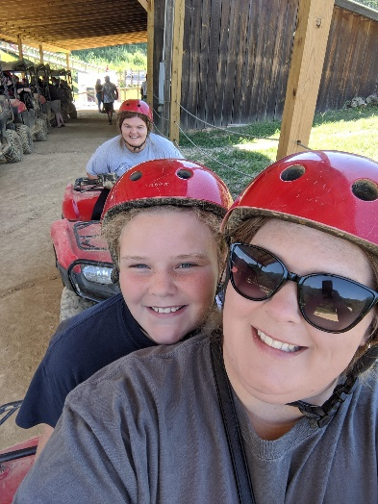
About Ms. Turner
I have been teaching for 7 years.
I am a Texas Native.
I have 2 children ages 10 and 17.
I enjoy going on adventures.
I am working on my Masters degree.
I have 2 dogs, Kinzie and Pretzels.
Every summer I take students to international destinations for Educational Adventures. Locations so far visited: Costa Rica, Belize, Ecuador and Galapagos Islands.
My next destination is Iceland 2021.
I teach science because I enjoy introducing fun to a subject that many people have anxiety about.

Slide 3
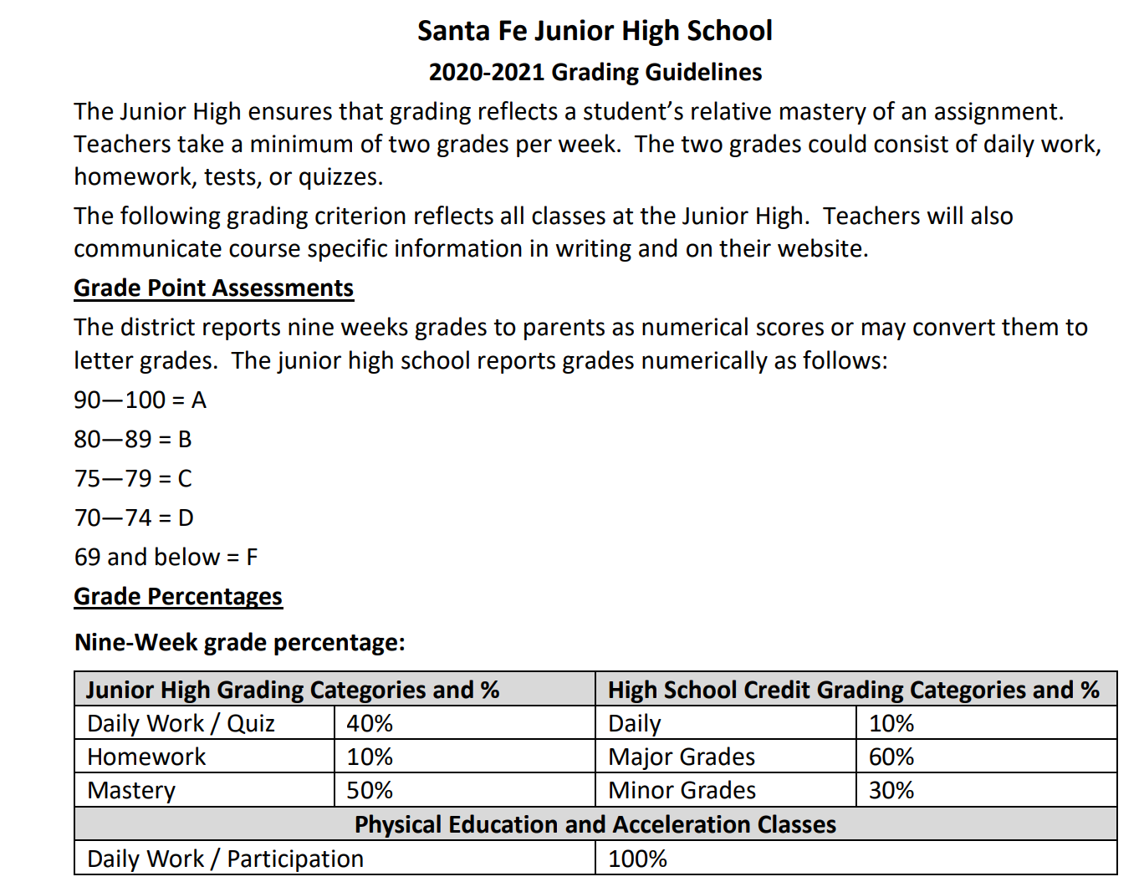
Grading policy

Slide 4
LAte work policy
Late Work Policy Santa Fe Junior High School Student Handbook
Assignments are due on time.
The late work point deduction is listed below:
1 day late = 10 point deduction
2 days late = 15 point deduction
3 days late = 20 point deduction
4 days late= 25 point deduction
5 days late= 30 point deduction
Any other penalty assignments must be approved by the principal.

Slide 5
Science pbis
When you participate in online learning, you have a responsibility. Please implement these digital expectations when interacting online.
1. communicate responsibility and kindly with one another.
2. protect our own and others' private information online.
3. stand up to cyberbullying.
4. respect each other's ideas and opinions.
5. Give proper credit when we use others' work.

Slide 6
Ms. Turner’s schedule
1st Period- 7:35-8:30
2nd Period-8:33-9:22
3rd Period- 9:25-10:14
4th Period- 10:17-11:06 (Conf.)
5th Period:11:09-11:58
C Lunch- 12:00-12:30
6th Period-12:32-1:21
7th Period-1:24-2:13
8th Period- 2:16-3:05 (PLC)

Slide 7
canvas
1. All work and announcements will be done through Canvas this year.
2. Canvas is a live document, so changes are expected. We will get through this together!!

Slide 8
Contact information
1. Email: Courtney.turner@sfisd.org
2. Phone: 409-925-9300

