Slide 1
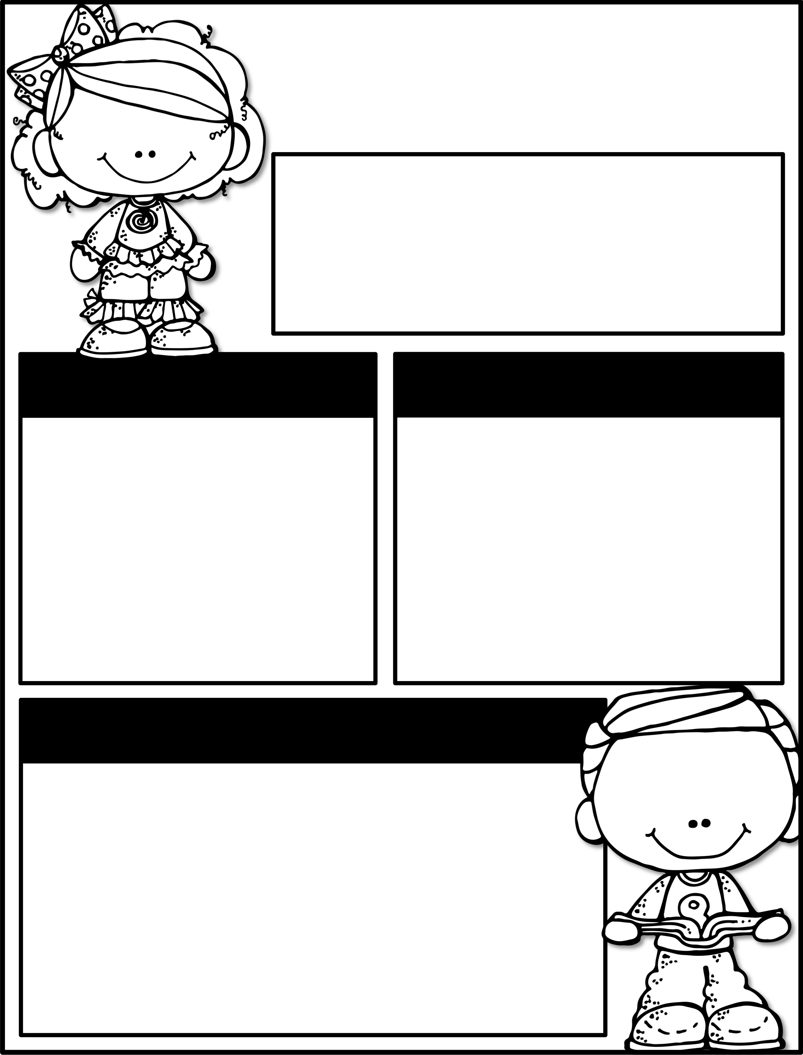
Oct. 7th-10th
Parent Tip of the Week:
Ask your child what their favorite storybook is.
Upcoming Events
Reminders
No School-
October 11^{th-}14th
End of the 1st Nine Weeks-
October 18th
Red Ribbon Week-
Oct. 28th-Oct. 31st
Practice your alphabet and sight word cards every night!
We will be assessing for report cards this week. Please try to have your child at school if possible.
Thank you!
Learning Focus
Reading
Emergent Reading
Writing
Show and Tell
Social Studies
Our School Community
Math
Reading, Writing, & Representing Numbers to 10
Science
Exploring Energy

