Slide 1
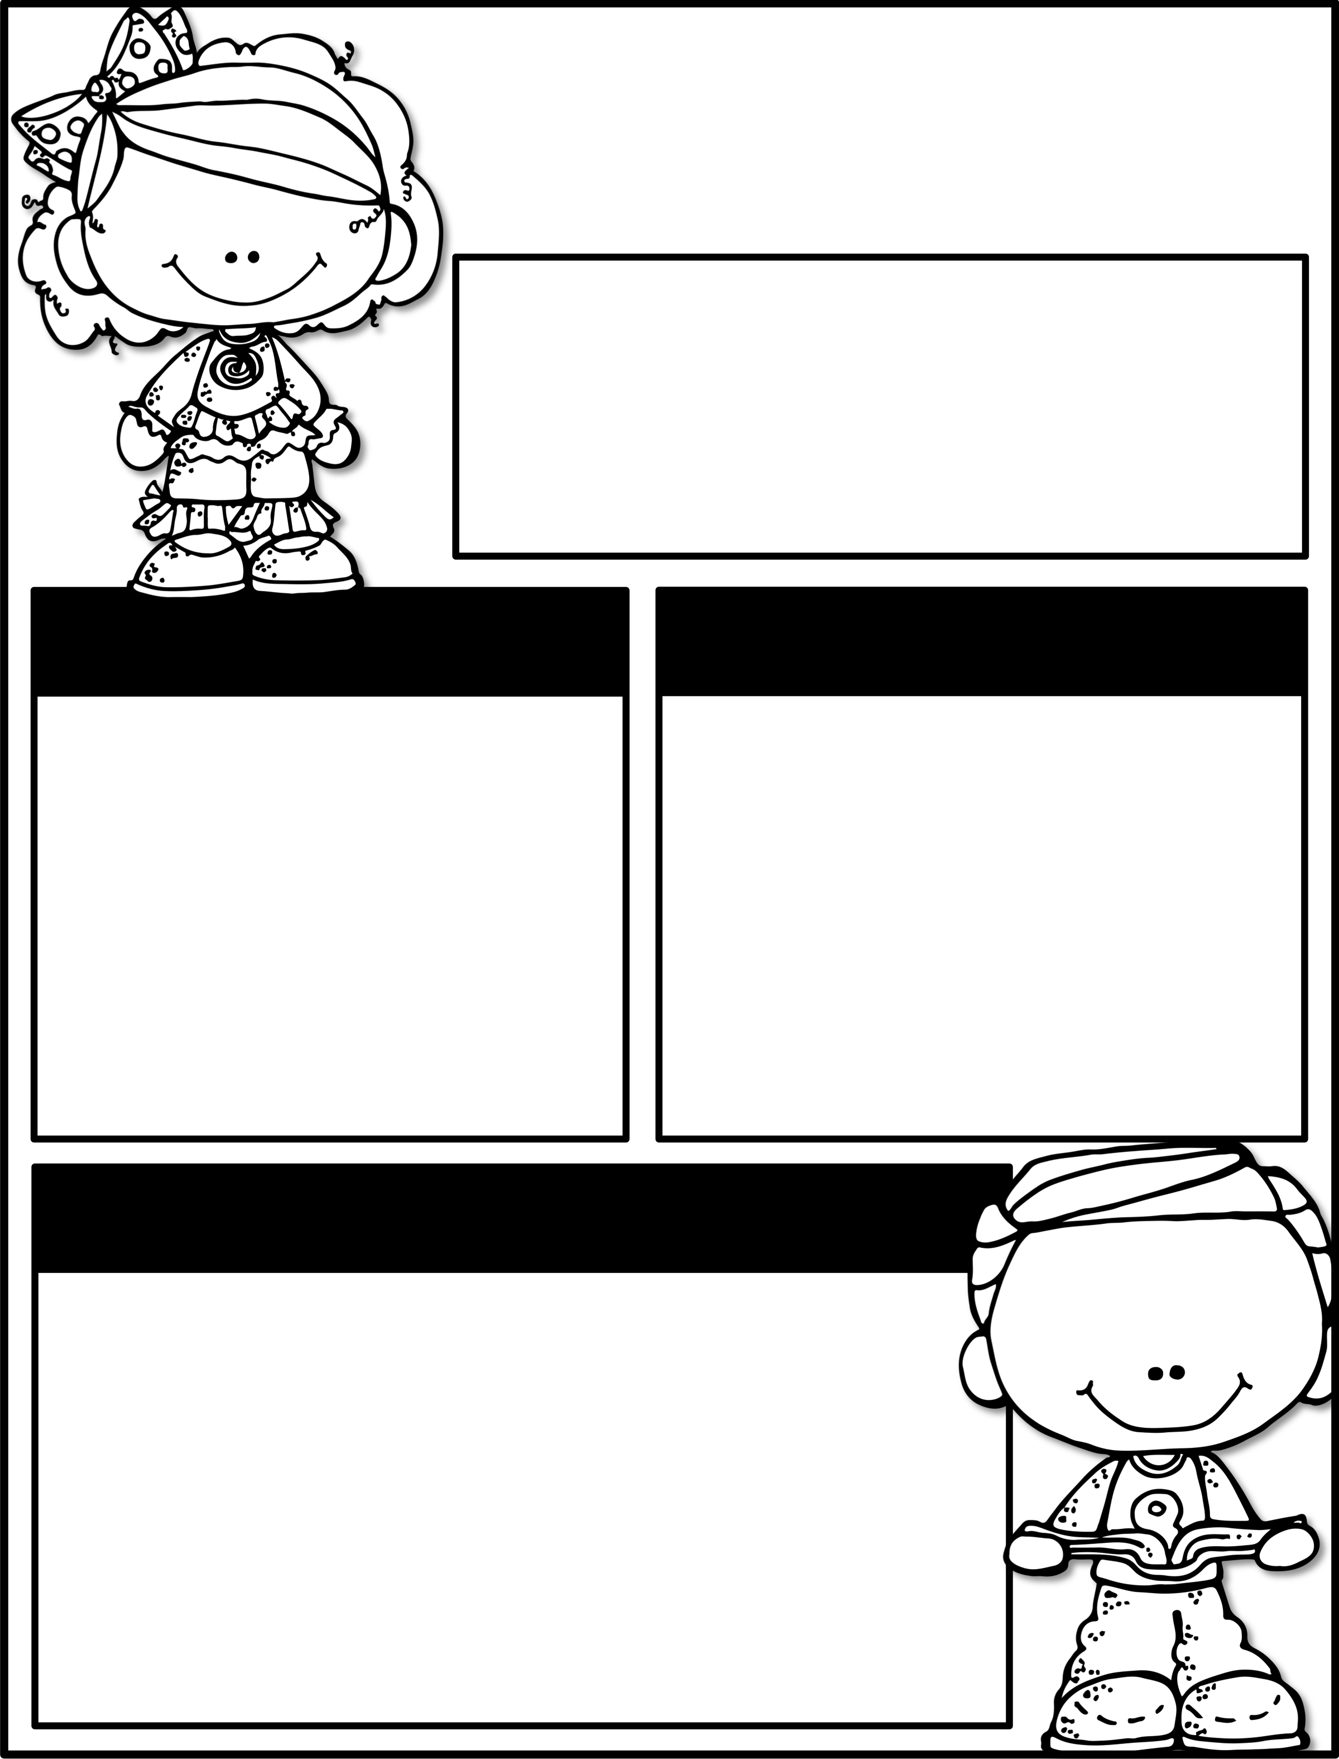
September 21st-25th
Parent Tip of the Week:
Ask your child who they played with at recess.
Upcoming Events
Reminders
Sept. 24th
Picture Day for F2F
Oct. 2nd
Johnny Appleseed Day
October 9th & 12th
NO SCHOOL
Please practice daily:
Alphabet cards
Sight word cards
Writing 1st name
Writing numbers
Opening lunch items
Tying shoes
Learning Focus
Reading
We Are Readers
Writing
Launching the Writing Workshop
Math
Numbers 6-10
Science
Heating/Cooling &
Freezing/Melting
Social Studies
American/Texas Flags
& Citizenship

