Slide 1
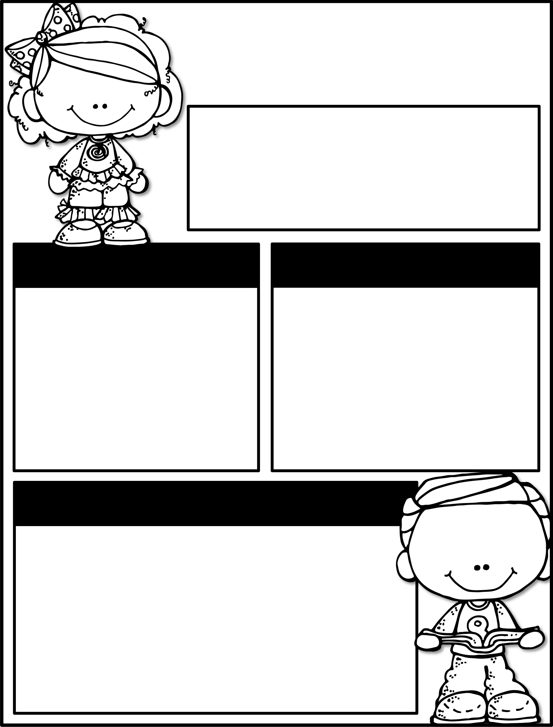
January 27th – 31st
Parent Tip of the Week:
Allow your child to help set the table for dinner.
Upcoming Events
Reminders
January 29th:
Beauty & the Beast
February 6th:
100th Day of School
February 7th:
House Gathering
** WEAR YOUR CLASS SHIRT TO BEAUTY & THE BEAST @ Santa Fe High School!
** We are in need of snacks.
** Note: The students will be having a Valentine’s Day card exchange on February 13th , NOT a party.
Learning Focus
Reading
Bigger Books,
Bigger Reading Muscles
Writing
How-to Books
Social Studies
Geography and Places
Math
Comparing Numbers
to 20
Sums & Minuends to 10
Science
Observing Objects
in the Sky

