Slide 1
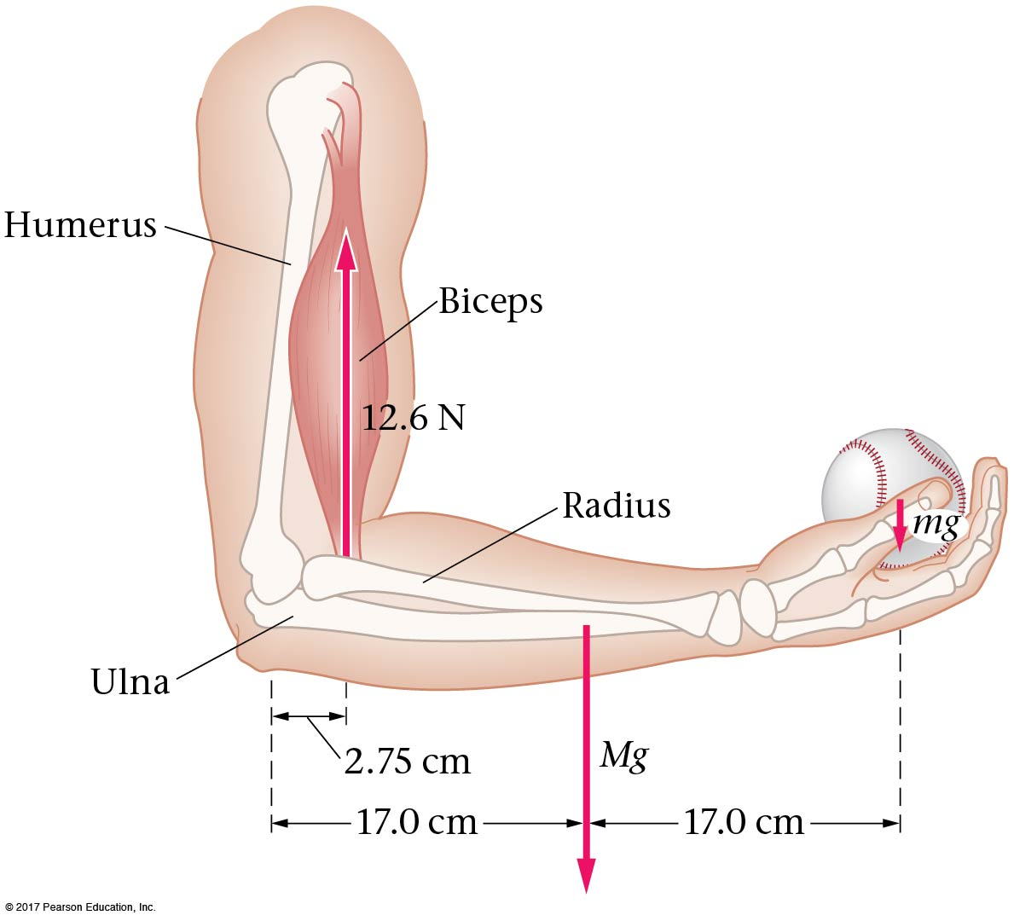
Rotational Dynamics and Static Equilibrium

Slide 2
Torque
Torque and Angular Acceleration
Zero Torque and Static Equilibrium
Center of Mass and Balance
Dynamic Applications of Torque
Angular Momentum
Conservation of Angular Momentum
Rotational Work and Power
The Vector Nature of Rotational Motion

Slide 3
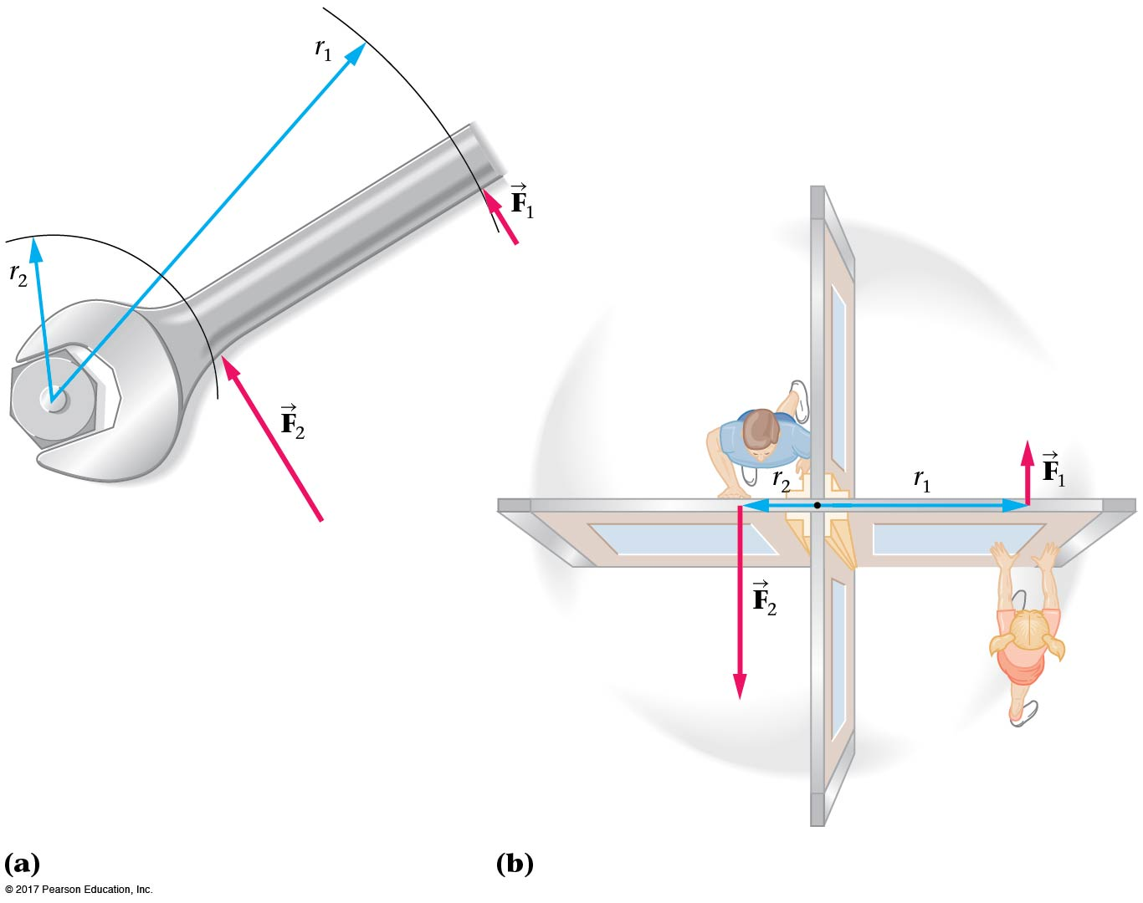
11-1 Torque
From experience, we know that the same force will be much more effective at rotating an object such as a nut or a door if our hand is not too close to the axis.
This is why we have long-handled wrenches, and why doorknobs are not next to hinges.

Slide 4
11-1 Torque
We define a quantity called torque:
The torque increases as the force increases, and also as the distance increases.

Slide 5
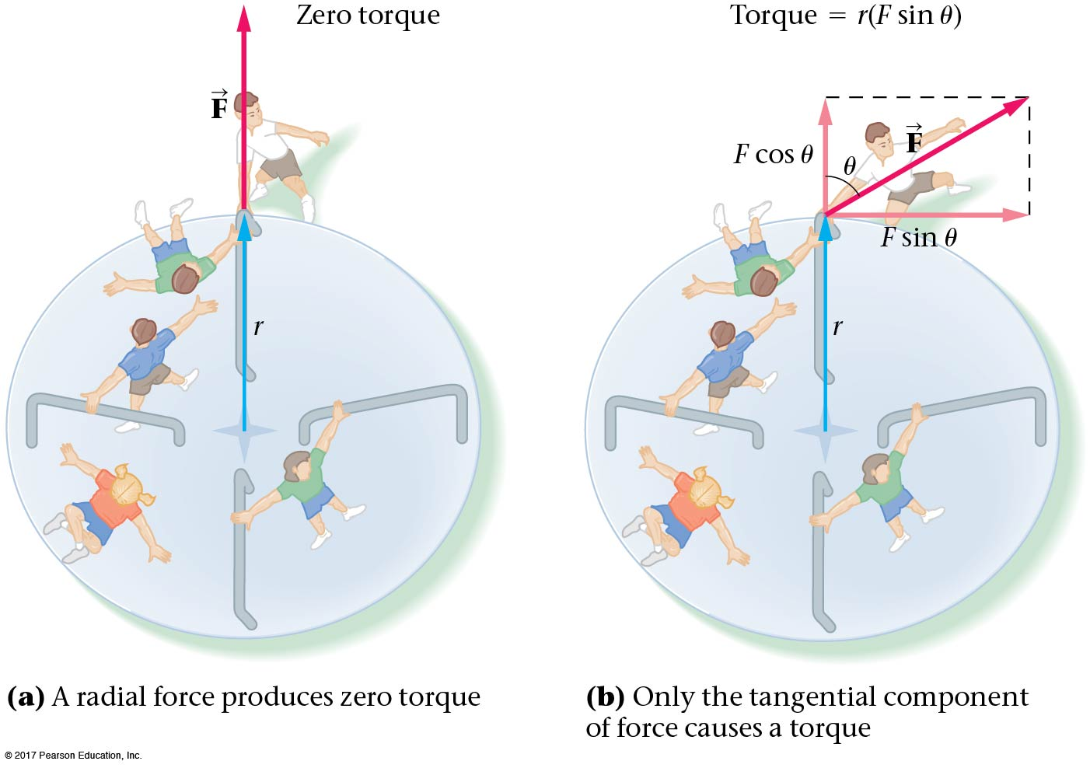
11-1 Torque
Only the tangential component of force causes a torque:

Slide 6
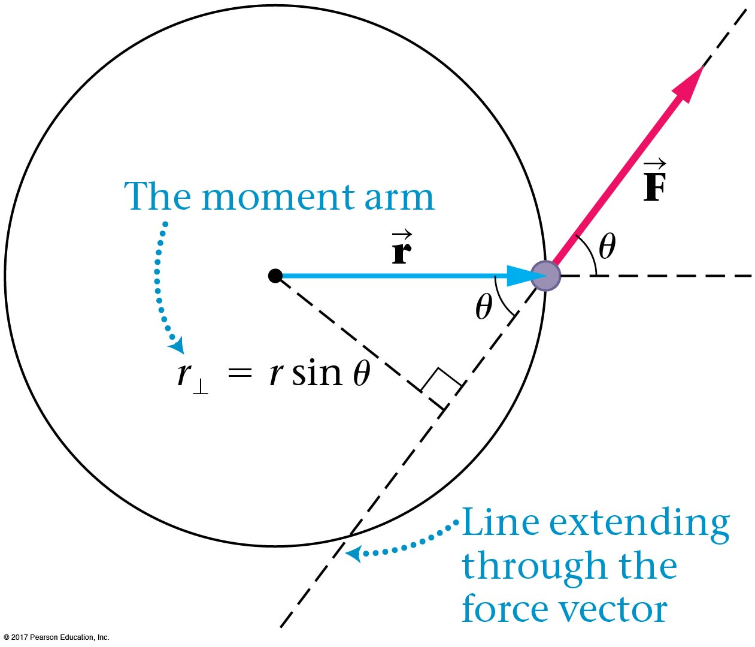
11-1 Torque
This leads to a more general definition of torque:

Slide 7
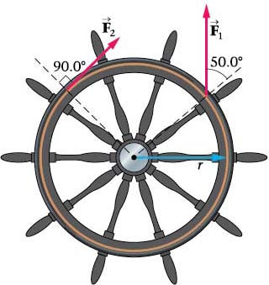
11-1 Torque
If the torque causes a counterclockwise angular acceleration, it is positive; if it causes a clockwise angular acceleration, it is negative.

Slide 8
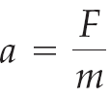
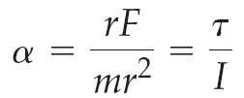
11-2 Torque and Angular Acceleration
Newton’s second law:
If we consider a mass m rotating around an axis a distance r away, we can reformat Newton’s second law to read:
Or equivalently,

Slide 9
11-2 Torque and Angular Acceleration
Once again, we have analogies between linear and angular motion:

Slide 10
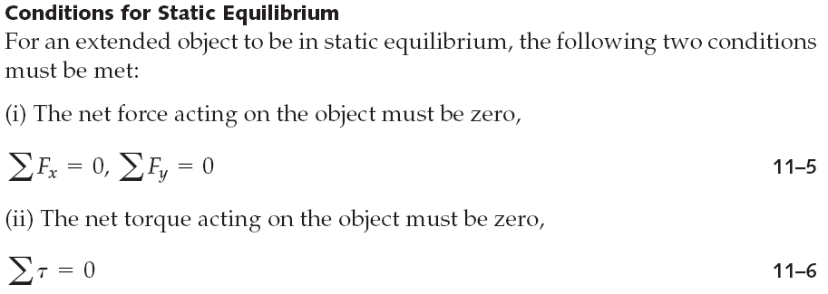
11-3 Zero Torque and Static Equilibrium
Static equilibrium occurs when an object is at rest—neither rotating nor translating.

Slide 11
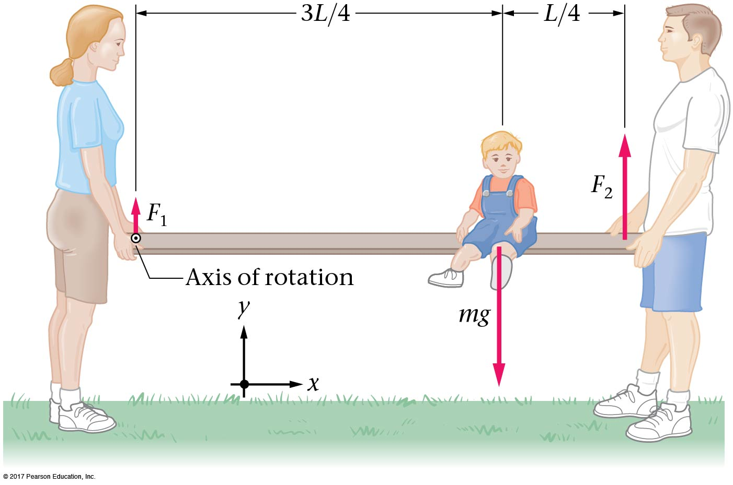
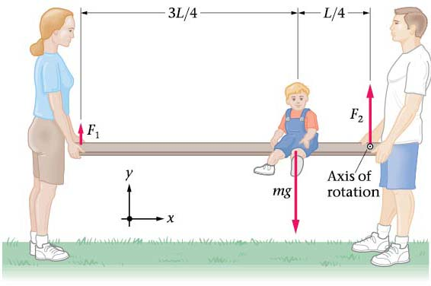
11-3 Zero Torque and Static Equilibrium
If the net torque is zero, it doesn’t matter which axis we consider rotation to be around; we are free to choose the one that makes our calculations easiest.

Slide 12
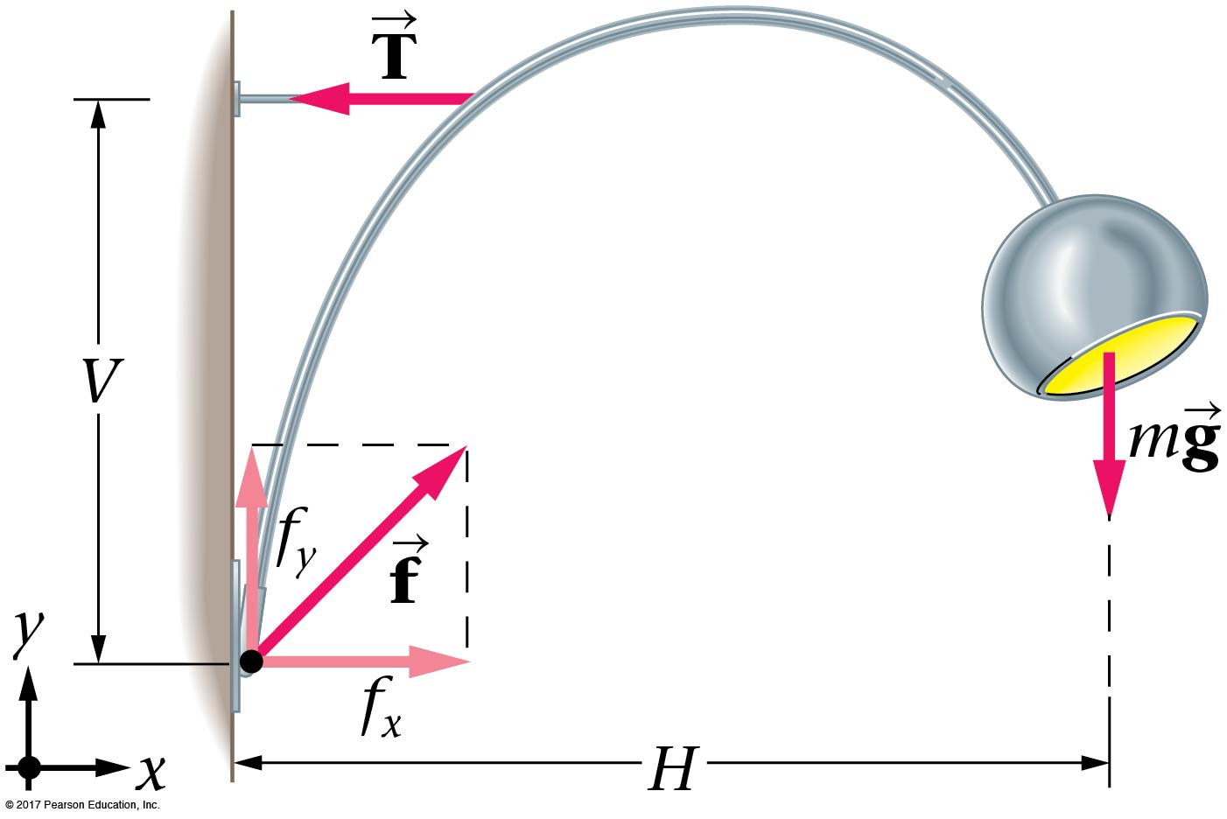
11-3 Zero Torque and Static Equilibrium
When forces have both vertical and horizontal components, in order to be in equilibrium, an object must have no net torque, and no net force in either the x- or y-direction.

Slide 13
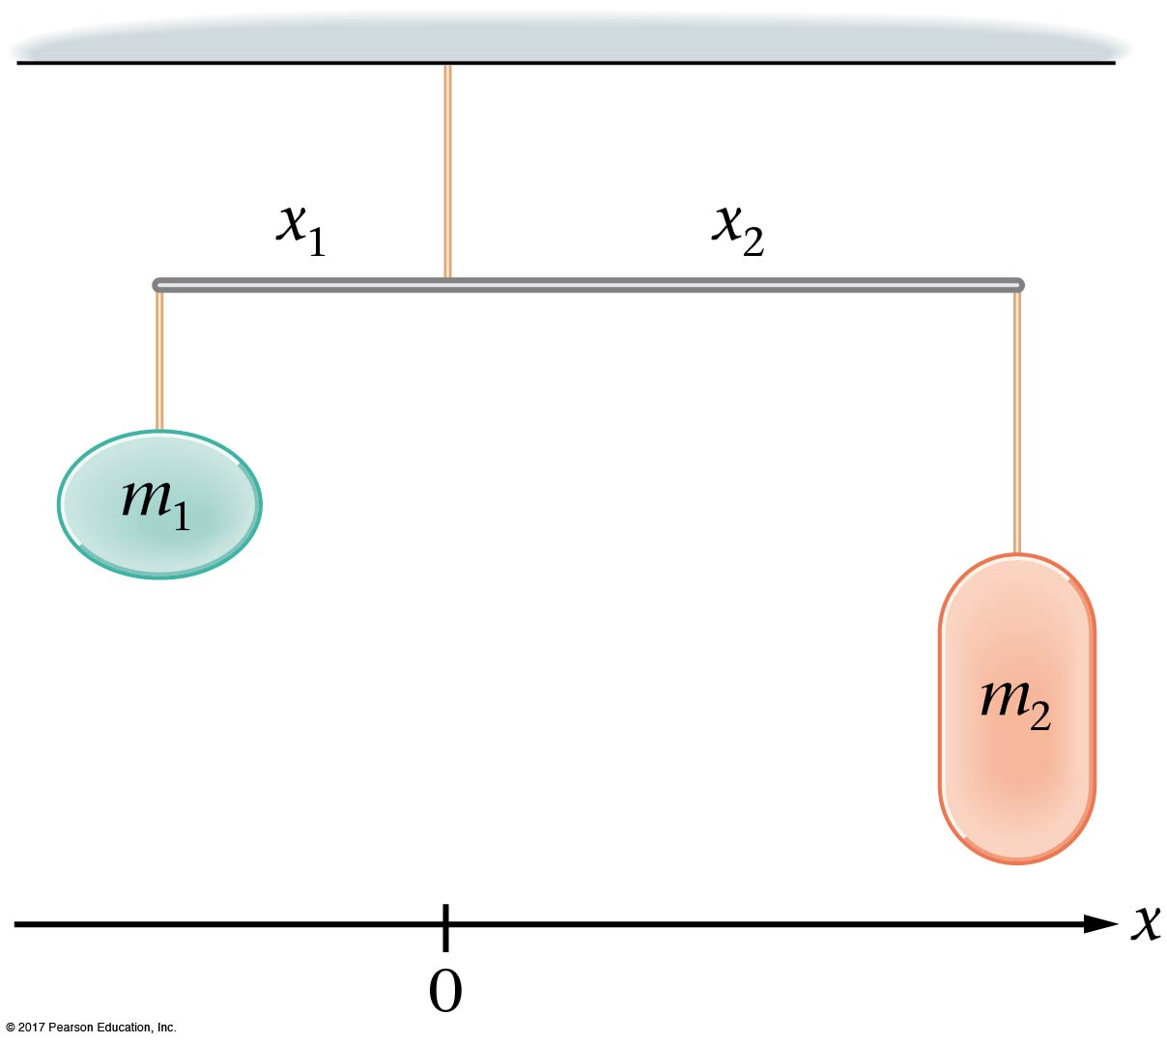
11-4 Center of Mass and Balance
If an extended object is to be balanced, it must be supported through its center of mass.

Slide 14
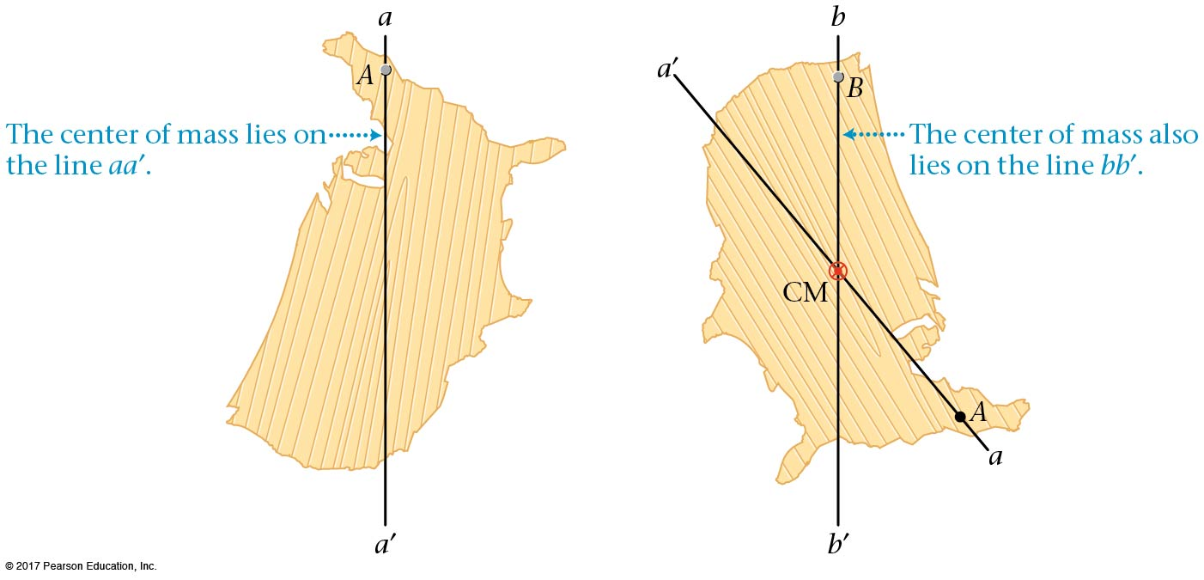
11-4 Center of Mass and Balance
This fact can be used to find the center of mass of an object—suspend it from different axes and trace a vertical line. The center of mass is where the lines meet.

Slide 15
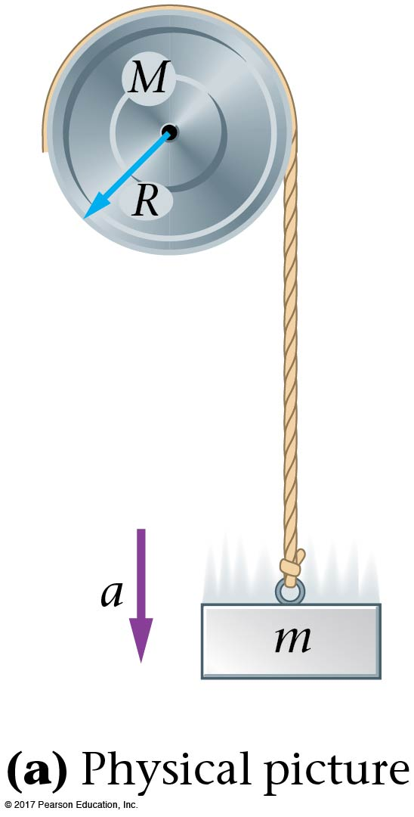
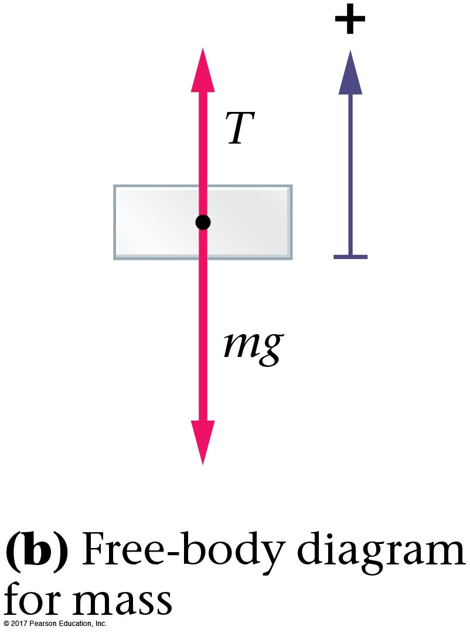
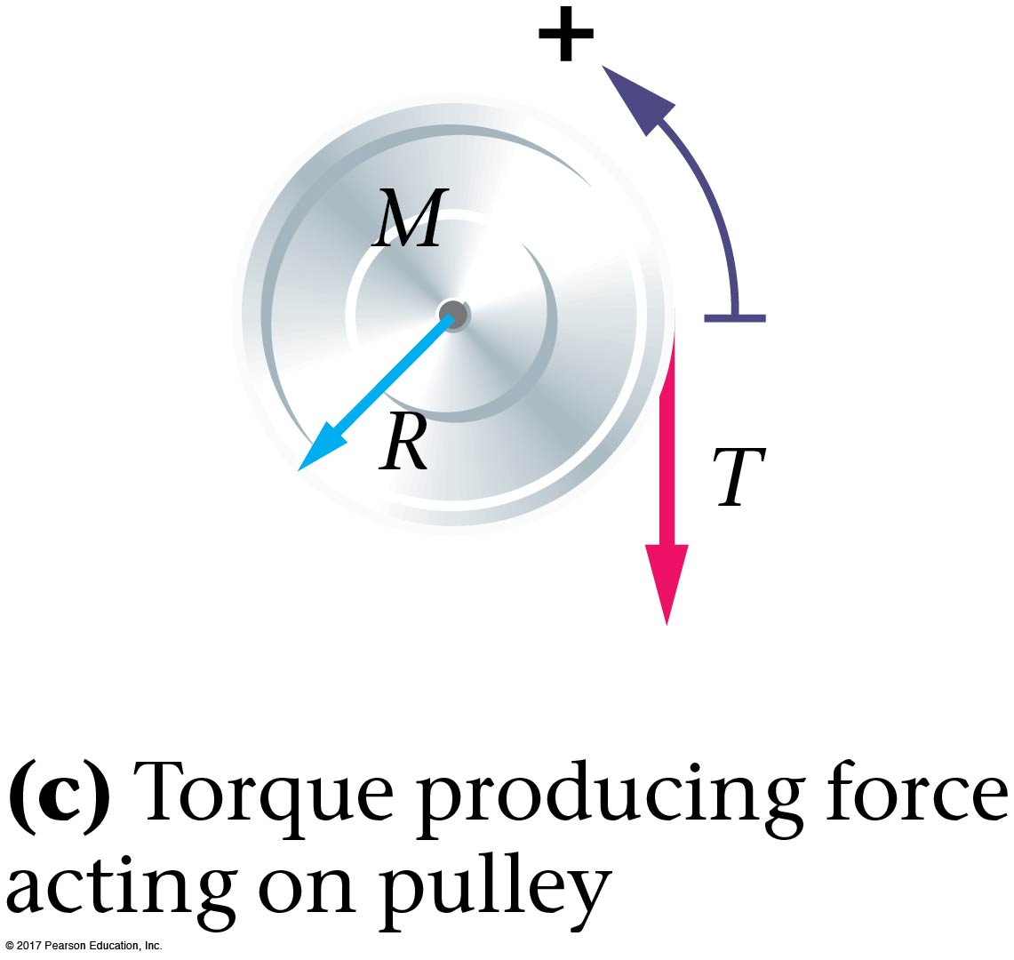
11-5 Dynamic Applications of Torque
When dealing with systems that have both rotating parts and translating parts, we must be careful to account for all forces and torques correctly.

Slide 16
11-6 Angular Momentum
Using a bit of algebra, we find for a particle moving in a circle of radius r,

Slide 17
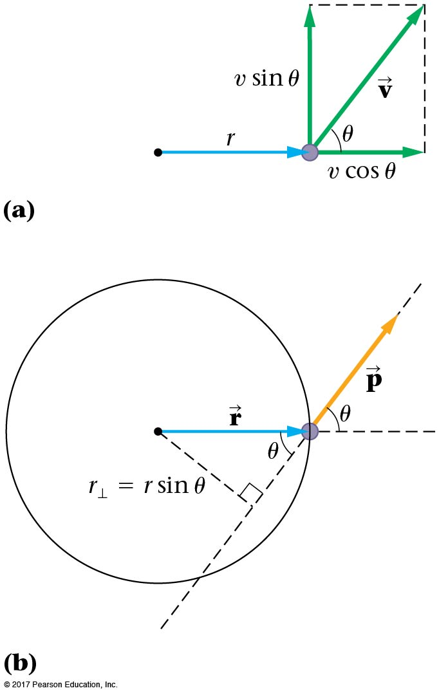
11-6 Angular Momentum
For more general motion,

Slide 18
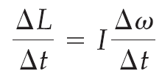
11-6 Angular Momentum
Looking at the rate at which angular momentum changes,

Slide 19
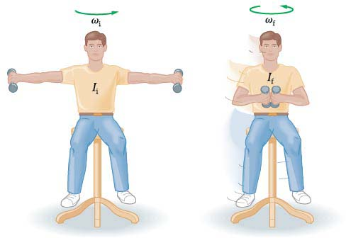
11-7 Conservation of Angular Momentum
If the net external torque on a system is zero, the angular momentum is conserved.
The most interesting consequences occur in systems that are able to change shape:

Slide 20
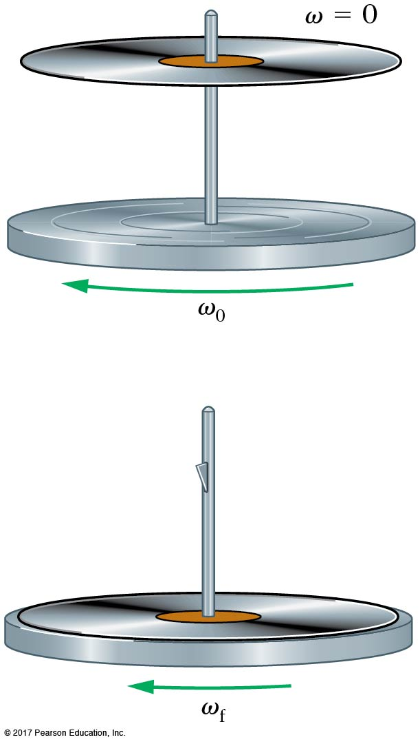
11-7 Conservation of Angular Momentum
As the moment of inertia decreases, the angular speed increases, so the angular momentum does not change.
Angular momentum is also conserved in rotational collisions:

Slide 21
11-8 Rotational Work and Power
A torque acting through an angular displacement does work, just as a force acting through a distance does.
The work–energy theorem applies as usual.

Slide 22
11-8 Rotational Work and Power
Power is the rate at which work is done, for rotational motion as well as for translational motion.
Again, note the analogy to the linear form:

Slide 23
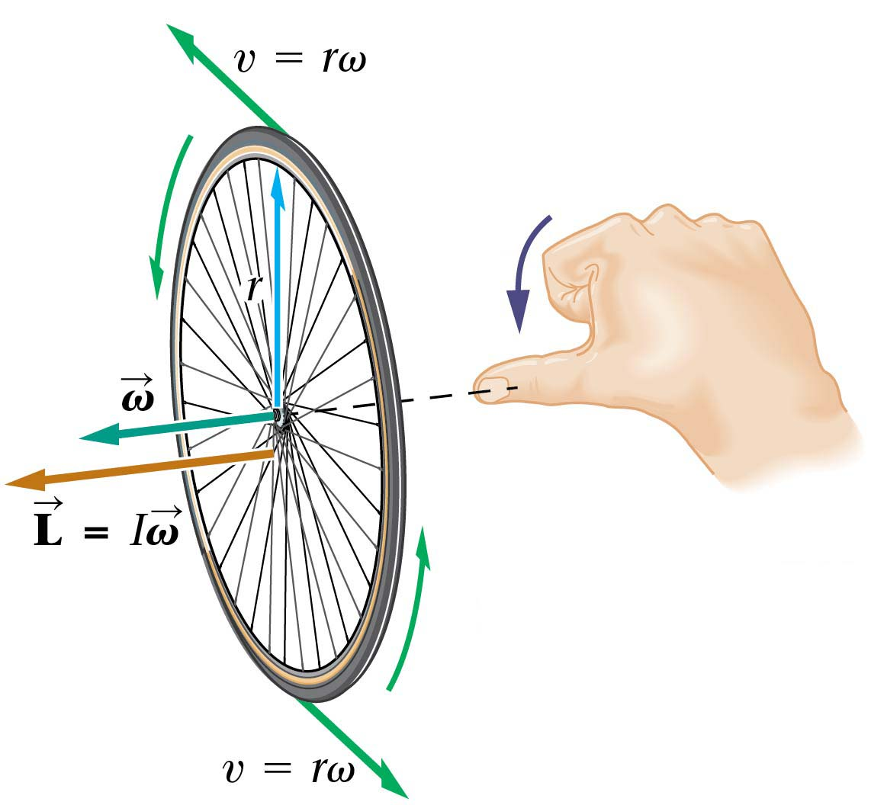
11-9 The Vector Nature of Rotational Motion
The direction of the angular velocity vector is along the axis of rotation. A right-hand rule gives the sign.

Slide 24
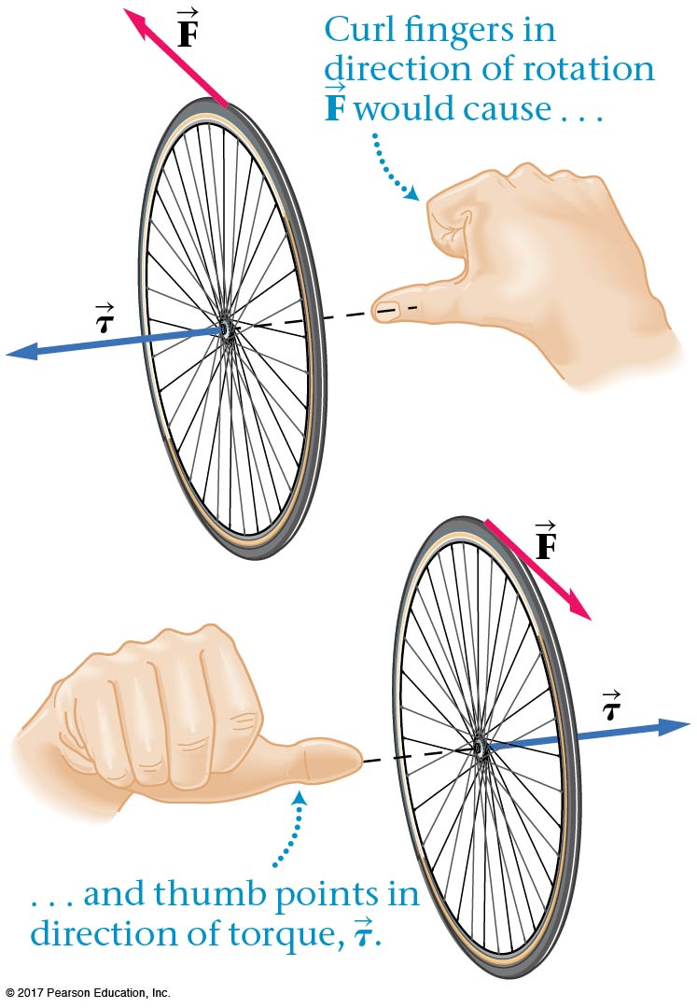
11-9 The Vector Nature of Rotational Motion
A similar right-hand rule gives the direction of the torque.

Slide 25
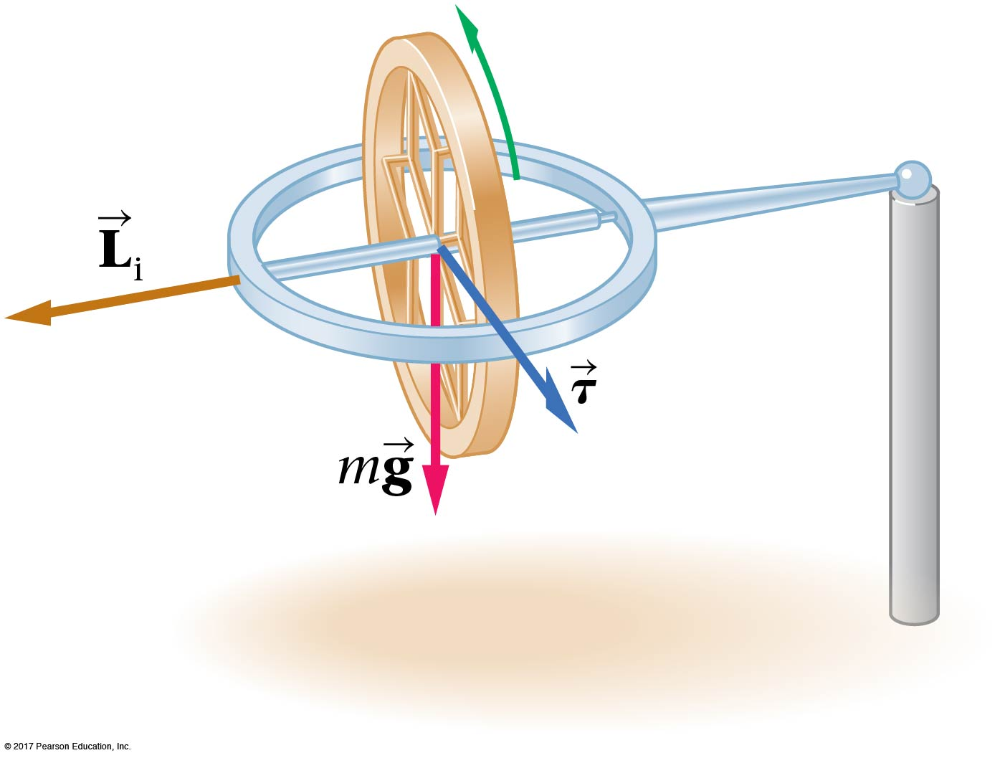
11-9 The Vector Nature of Rotational Motion
Conservation of angular momentum means that the total angular momentum around any axis must be constant. This is why gyroscopes are so stable.

Slide 26
Summary of Chapter 11
A force applied so as to cause an angular acceleration is said to exert a torque.
Torque due to a tangential force:
Torque in general:
Newton’s second law for rotation:
In order for an object to be in static equilibrium, the total force and the total torque acting on the object must be zero.
An object balances when it is supported at its center of mass.

Slide 27
Summary of Chapter 11
In systems with both rotational and linear motion, Newton’s second law must be applied separately to each.
Angular momentum:
For tangential motion,
In general,
Newton’s second law:
In systems with no external torque, angular momentum is conserved.

Slide 28
Summary of Chapter 11
Work done by a torque:
Power:
Rotational quantities are vectors that point along the axis of rotation, with the direction given by the right-hand rule.

