Slide 1
Biology
Chapter 21 VIRUSES
PowerPoint Image Slideshow

Slide 2
Figure 21.1
The tobacco mosaic virus (left), seen here by transmission electron microscopy, was the first virus to be discovered. The virus causes disease in tobacco and other plants, such as the orchid (right). (credit a: USDA ARS; credit b: modification of work by USDA Forest Service, Department of Plant Pathology Archive North Carolina State University; scale-bar data from Matt Russell)

Slide 3
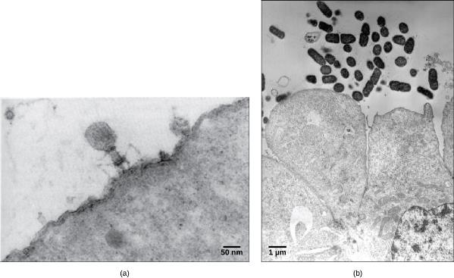
Figure 21.2
In these transmission electron micrographs, (a) a virus is dwarfed by the bacterial cell it infects, while (b) these E. coli cells are dwarfed by cultured colon cells. (credit a: modification of work by U.S. Dept. of Energy, Office of Science, LBL, PBD; credit b: modification of work by J.P. Nataro and S. Sears, unpub. data, CDC; scale-bar data from Matt Russell)

Slide 4
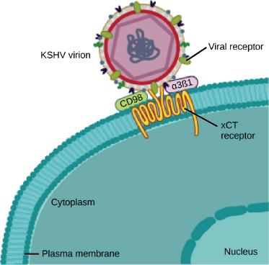
Figure 21.3
The KSHV virus binds the xCT receptor on the surface of human cells. xCT receptors protect cells against stress. Stressed cells express more xCT receptors than non-stressed cells. The KSHV virion causes cells to become stressed, thereby increasing expression of the receptor to which it binds. (credit: modification of work by NIAID, NIH)

Slide 5
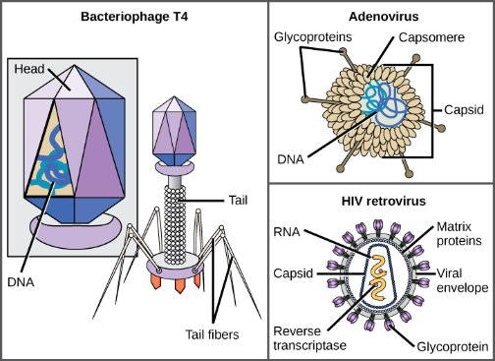
Figure 21.4
Viruses can be either complex in shape or relatively simple. This figure shows three relatively complex virions: the bacteriophage T4, with its DNA-containing head group and tail fibers that attach to host cells; adenovirus, which uses spikes from its capsid to bind to host cells; and HIV, which uses glycoproteins embedded in its envelope to bind to host cells. Notice that HIV has proteins called matrix proteins, internal to the envelope, which help stabilize virion shape. (credit “bacteriophage, adenovirus”: modification of work by NCBI, NIH; credit “HIV retrovirus”: modification of work by NIAID, NIH)

Slide 6
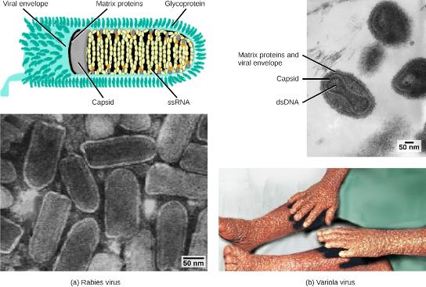
Figure 21.5
Viruses are classified based on their core genetic material and capsid design. (a) Rabies virus has a single-stranded RNA (ssRNA) core and an enveloped helical capsid, whereas (b) variola virus, the causative agent of smallpox, has a double-stranded DNA (dsDNA) core and a complex capsid. Rabies transmission occurs when saliva from an infected mammal enters a wound. The virus travels through neurons in the peripheral nervous system to the central nervous system where it impairs brain function, and then travels to other tissues. The virus can infect any mammal, and most die within weeks of infection. Smallpox is a human virus transmitted by inhalation of the variola virus, localized in the skin, mouth, and throat, which causes a characteristic rash. Before its eradication in 1979, infection resulted in a 30–35 percent mortality rate. (credit “rabies diagram”: modification of work by CDC; “rabies micrograph”: modification of work by Dr. Fred Murphy, CDC; credit “small pox micrograph”: modification of work by Dr. Fred Murphy, Sylvia Whitfield, CDC; credit “smallpox photo”: modification of work by CDC; scale-bar data from Matt Russell)

Slide 7
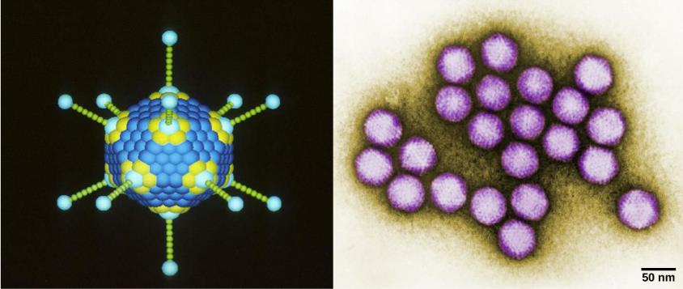
Figure 21.6
Adenovirus (left) is depicted with a double-stranded DNA genome enclosed in an icosahedral capsid that is 90–100 nm across. The virus, shown clustered in the micrograph (right), is transmitted orally and causes a variety of illnesses in vertebrates, including human eye and respiratory infections. (credit “adenovirus”: modification of work by Dr. Richard Feldmann, National Cancer Institute; credit “micrograph”: modification of work by Dr. G. William Gary, Jr., CDC; scale-bar data from Matt Russell)

Slide 8
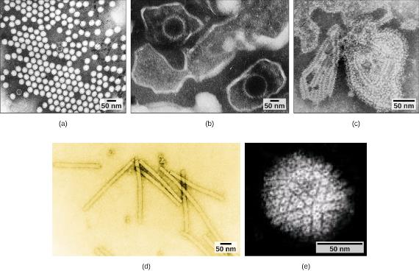
Figure 21.7
Transmission electron micrographs of various viruses show their structures. The capsid of the (a) polio virus is naked icosahedral; (b) the Epstein-Barr virus capsid is enveloped icosahedral; (c) the mumps virus capsid is an enveloped helix; (d) the tobacco mosaic virus capsid is naked helical; and (e) the herpesvirus capsid is complex. (credit a: modification of work by Dr. Fred Murphy, Sylvia Whitfield; credit b: modification of work by Liza Gross; credit c: modification of work by Dr. F. A. Murphy, CDC; credit d: modification of work by USDA ARS; credit e: modification of work by Linda Stannard, Department of Medical Microbiology, University of Cape Town, South Africa, NASA; scale-bar data from Matt Russell)

Slide 9
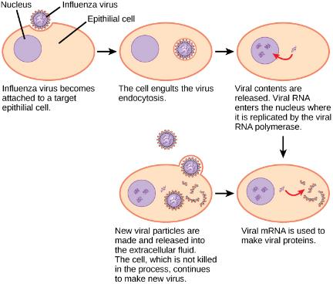
Figure 21.8
In influenza virus infection, glycoproteins attach to a host epithelial cell. As a result, the virus is engulfed. RNA and proteins are made and assembled into new virions.

Slide 10
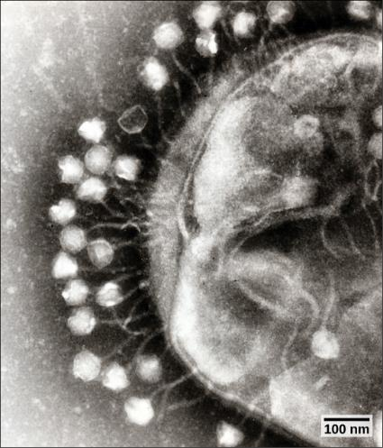
Figure 21.9
This transmission electron micrograph shows bacteriophages attached to a bacterial cell. (credit: modification of work by Dr. Graham Beards; scale-bar data from Matt Russell)

Slide 11
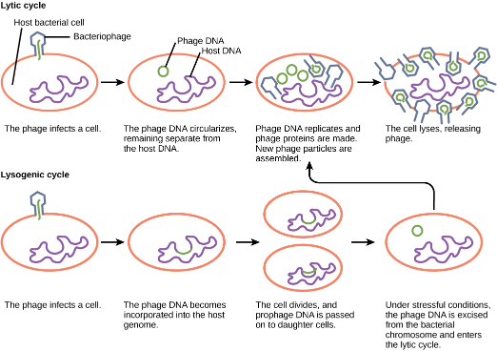
Figure 21.10
A temperate bacteriophage has both lytic and lysogenic cycles. In the lytic cycle, the phage replicates and lyses the host cell. In the lysogenic cycle, phage DNA is incorporated into the host genome, where it is passed on to subsequent generations. Environmental stressors such as starvation or exposure to toxic chemicals may cause the prophage to excise and enter the lytic cycle.

Slide 12
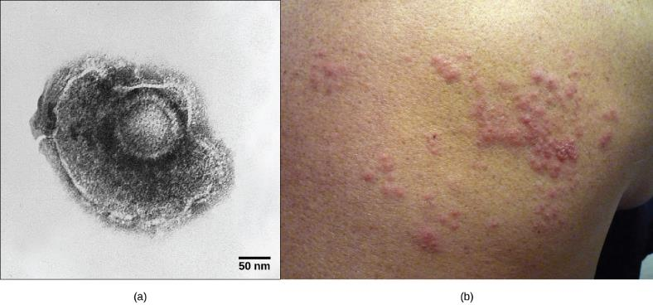
Figure 21.11
(a) Varicella-zoster, the virus that causes chickenpox, has an enveloped icosahedral capsid visible in this transmission electron micrograph. Its double-stranded DNA genome becomes incorporated in the host DNA and can reactivate after latency in the form of (b) shingles, often exhibiting a rash. (credit a: modification of work by Dr. Erskine Palmer, B. G. Martin, CDC; credit b: modification of work by “rosmary”/Flickr; scale-bar data from Matt Russell)

Slide 13
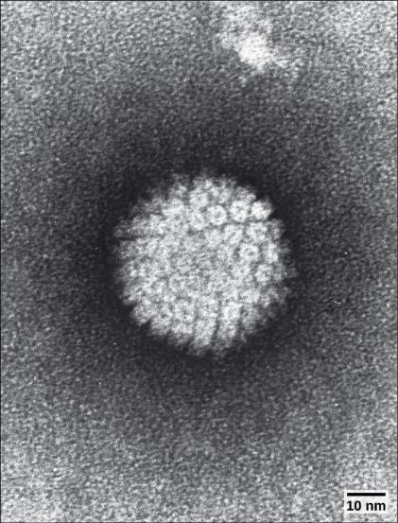
Figure 21.12
HPV, or human papillomavirus, has a naked icosahedral capsid visible in this transmission electron micrograph and a double-stranded DNA genome that is incorporated into the host DNA. The virus, which is sexually transmitted, is oncogenic and can lead to cervical cancer. (credit: modification of work by NCI, NIH; scale-bar data from Matt Russell)

Slide 14
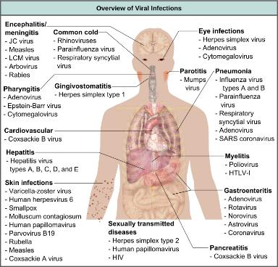
Figure 21.13
Viruses can cause dozens of ailments in humans, ranging from mild illnesses to serious diseases. (credit: modification of work by Mikael Häggström)

Slide 15
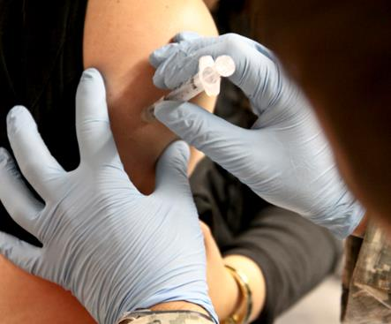
Figure 21.14
Vaccinations are designed to boost immunity to a virus to prevent infection. (credit: USACE Europe District)

Slide 16
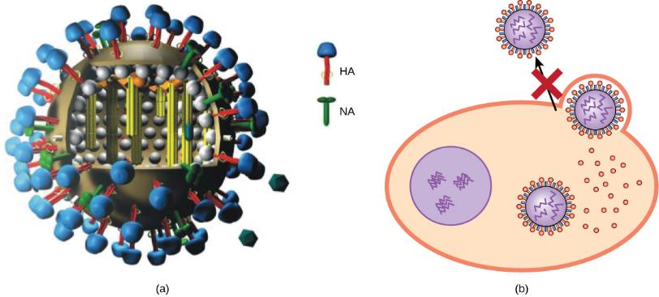
Figure 21.15
(a) Tamiflu inhibits a viral enzyme called neuraminidase (NA) found in the influenza viral envelope. (b) Neuraminidase cleaves the connection between viral hemagglutinin (HA), also found in the viral envelope, and glycoproteins on the host cell surface. Inhibition of neuraminidase prevents the virus from detaching from the host cell, thereby blocking further infection. (credit a: modification of work by M. Eickmann)

Slide 17
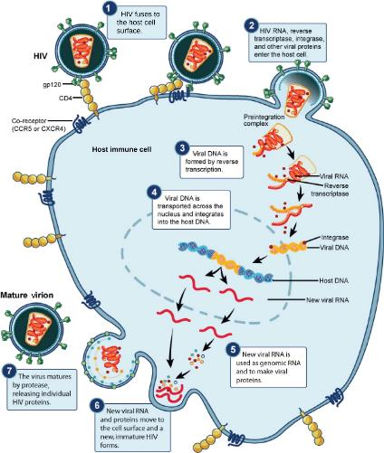
Figure 21.16
HIV, an enveloped, icosahedral virus, attaches to the CD4 receptor of an immune cell and fuses with the cell membrane. Viral contents are released into the cell, where viral enzymes convert the single-stranded RNA genome into DNA and incorporate it into the host genome. (credit: NIAID, NIH)

Slide 18
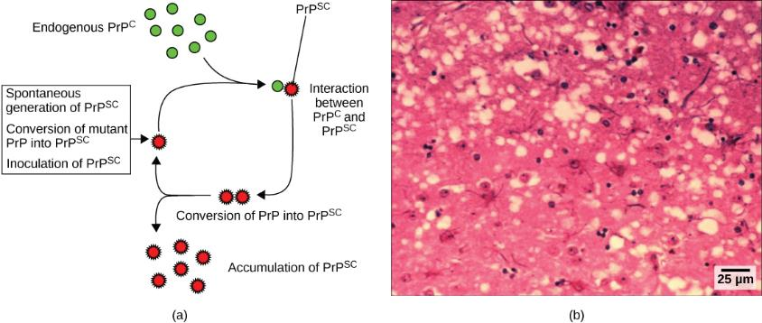
Figure 21.17
Endogenous normal prion protein (PrP^{c}) is converted into the disease-causing form (PrP^{sc}) when it encounters this variant form of the protein. PrP^{sc} may arise spontaneously in brain tissue, especially if a mutant form of the protein is present, or it may occur via the spread of misfolded prions consumed in food into brain tissue.
This prion-infected brain tissue, visualized using light microscopy, shows the vacuoles that give it a spongy texture, typical of transmissible spongiform encephalopathies. (credit b: modification of work by Dr. Al Jenny, USDA APHIS; scale-bar data from Matt Russell)

Slide 19
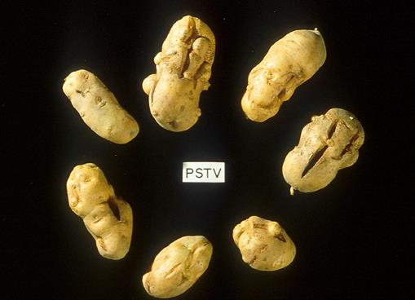
Figure 21.18
These potatoes have been infected by the potato spindle tuber viroid (PSTV), which is typically spread when infected knives are used to cut healthy potatoes, which are then planted. (credit: Pamela Roberts, University of Florida Institute of Food and Agricultural Sciences, USDA ARS)

Slide 20
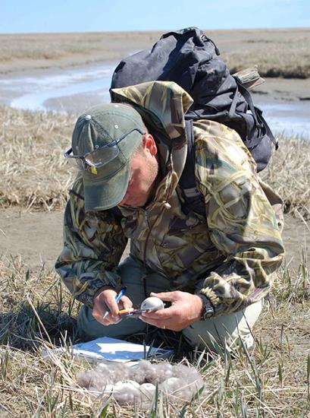
Figure 21.19
This virologist is engaged in fieldwork, sampling eggs from this nest for avian influenza. (credit: Don Becker, USGS EROS, U.S. Fish and Wildlife Service)

