Slide 1
Biology
Chapter 19 THE EVOLUTION OF POPULATIONS
PowerPoint Image Slideshow

Slide 2
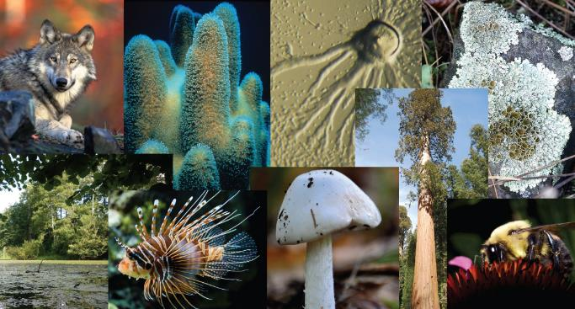
Figure 19.1
Living things may be single-celled or complex, multicellular organisms. They may be plants, animals, fungi, bacteria, or archaea. This diversity results from evolution. (credit “wolf”: modification of work by Gary Kramer; credit “coral”: modification of work by William Harrigan, NOAA; credit “river”: modification of work by Vojtěch Dostál; credit “fish" modification of work by Christian Mehlführer; credit “mushroom”: modification of work by Cory Zanker; credit “tree”: modification of work by Joseph Kranak; credit “bee”: modification of work by Cory Zanker)

Slide 3
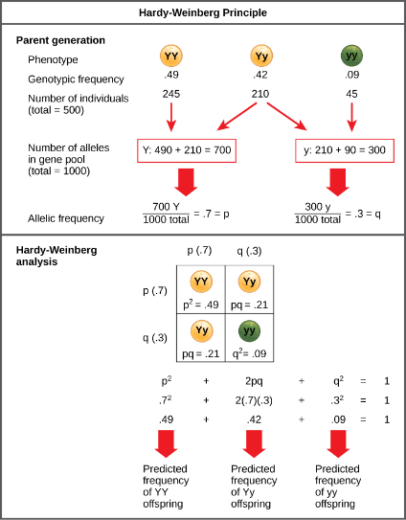
Figure 19.2
When populations are in the Hardy-Weinberg equilibrium, the allelic frequency is stable from generation to generation and the distribution of alleles can be determined from the Hardy-Weinberg equation. If the allelic frequency measured in the field differs from the predicted value, scientists can make inferences about what evolutionary forces are at play.

Slide 4
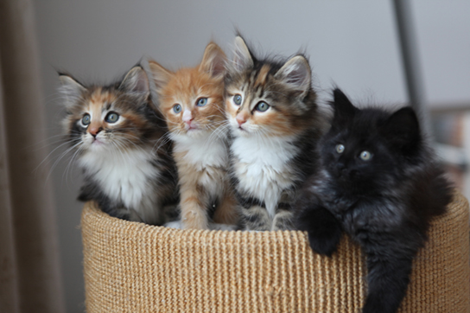
Figure 19.3
The distribution of phenotypes in this litter of kittens illustrates population variation. (credit: Pieter Lanser)

Slide 5
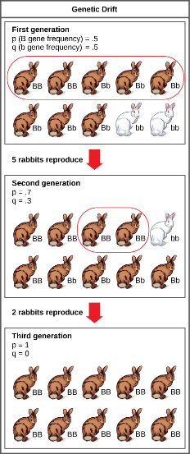
Figure 19.4
Genetic drift in a population can lead to the elimination of an allele from a population by chance. In this example, rabbits with the brown coat color allele (B) are dominant over rabbits with the white coat color allele (b). In the first generation, the two alleles occur with equal frequency in the population, resulting in p and q values of .5. Only half of the individuals reproduce, resulting in a second generation with p and q values of .7 and .3, respectively. Only two individuals in the second generation reproduce, and by chance these individuals are homozygous dominant for brown coat color. As a result, in the third generation the recessive b allele is lost.

Slide 6
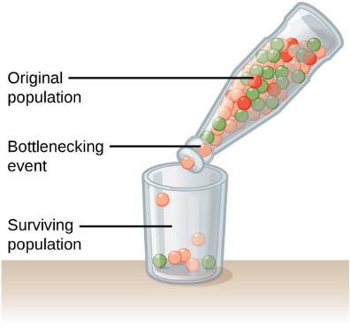
Figure 19.5
A chance event or catastrophe can reduce the genetic variability within a population.

Slide 7
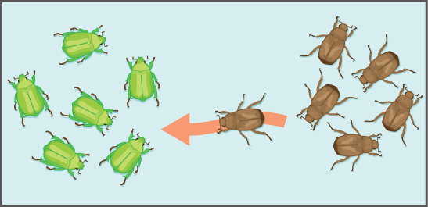
Figure 19.6
Gene flow can occur when an individual travels from one geographic location to another.

Slide 8
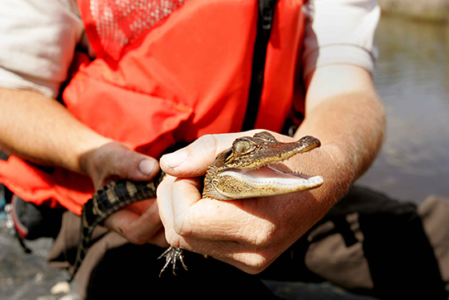
Figure 19.7
The sex of the American alligator (Alligator mississippiensis) is determined by the temperature at which the eggs are incubated. Eggs incubated at 30°C produce females, and eggs incubated at 33°C produce males. (credit: Steve Hillebrand, USFWS)

Slide 9
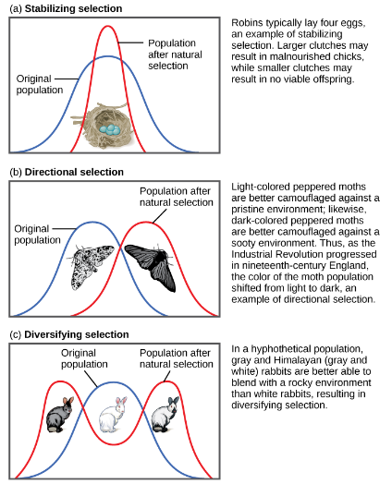
Figure 19.8
Figure 19.8 Different types of natural selection can impact the distribution of phenotypes within a population. In (a) stabilizing selection, an average phenotype is favored. In (b) directional selection, a change in the environment shifts the spectrum of phenotypes observed. In (c) diversifying selection, two or more extreme phenotypes are selected for, while the average phenotype is selected against.

Slide 10
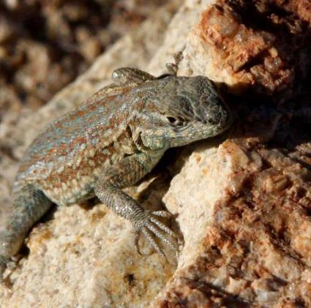
Figure 19.9
A yellow-throated side-blotched lizard is smaller than either the blue-throated or orange-throated males and appears a bit like the females of the species, allowing it to sneak copulations. (credit: “tinyfroglet”/Flickr)

Slide 11
Figure 19.10
Sexual dimorphism is observed in (a) peacocks and peahens, (b) Argiope appensa spiders (the female spider is the large one), and in (c) wood ducks. (credit “spiders”: modification of work by “Sanba38”/Wikimedia Commons; credit “duck”: modification of work by Kevin Cole)

